Slide 1
Survival Analysis of Bladder Cancer Recurrence Using Cox and Parametric Models
Kwaku Gyimah
03/26/2025

Slide 2
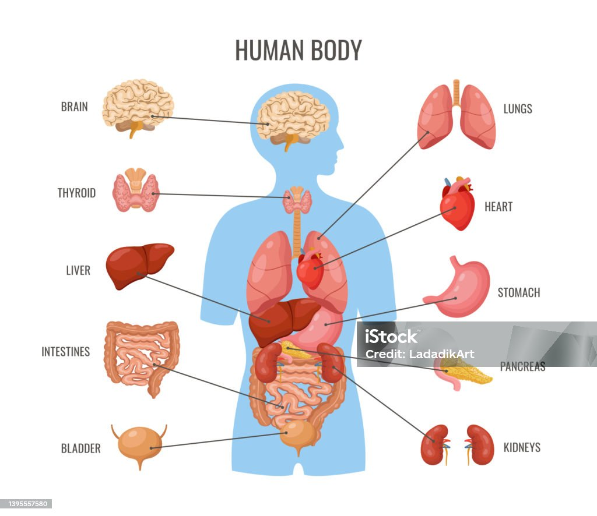

Slide 3


Slide 4
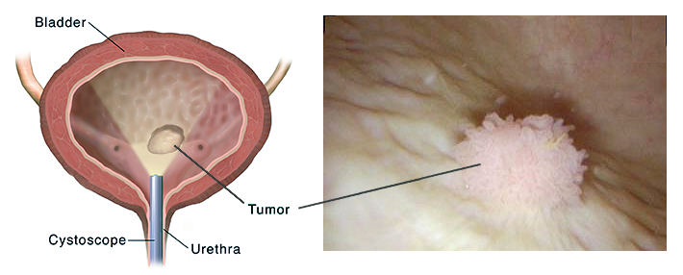
What is Bladder Cancer
Bladder cancer is a type of cancer that begins in the tissues of the bladder, the organ in the lower abdomen that stores urine.
It commonly starts in the urothelial cells that line the inside of the bladder.
There are two main types: Non-muscle-invasive bladder cancer (NMIBC), which is confined to the inner layers of the bladder wall, and Muscle-invasive bladder cancer (MIBC), which spreads into the muscle layer.
NMIBC is more common and generally less life-threatening but is known for its high recurrence rate—up to 80% of patients may experience cancer coming back after initial treatment.

Slide 5

Why does this Study Matter?

Slide 6

Bladder cancer is expensive and difficult to manage.
Notes:
It can literally affect your everyday life and life choices in many ways.

Slide 7

Finding what factors influence recurrence helps doctors treat patients better.

Slide 8

Thiotepa
Thiotepa injection is used to treat certain types of cancer.

Slide 9
Research Question
Does treatment type (Thiotepa vs. Placebo) affect how soon cancer comes back (recurrence)?
Do tumor size and number of tumors matter?

Slide 10
Study Data and Variables
85 Patients, 340 observations.
Key variables:
Treatment (Thiotepa or Placebo)
Tumor size
Number of tumors
Time to recurrence (or not!)

Slide 11
Treatment Groups and Tumor Characteristics
Treatment Group | Number of Observations | Mean Tumor Size (cm) | Mean Tumor Count | Recurrence Events
Placebo (rx=1) | 188 | 2.18 | 2.31 | 72
Thiotepa (rx=2) | 152 | 1.79 | 1.83 | 40

Slide 12
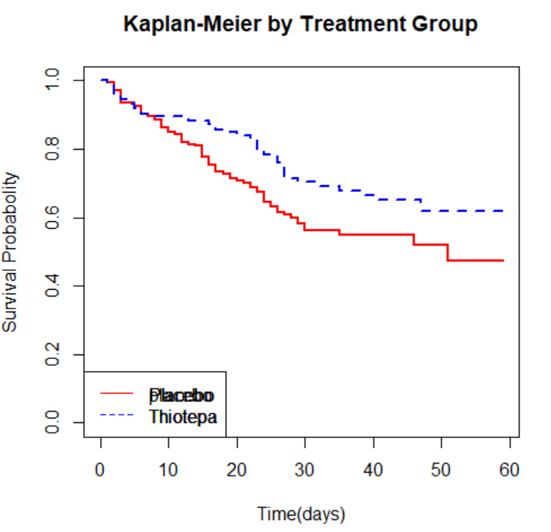
Kaplan-Meier by Treatment
This graph compares survival by treatment group.
Red (Placebo) declines faster than Blue (Thiotepa), indicating thiotepa patients had better survival.

Slide 13
Log Rank Test Result
Comparison | Chi-square | Degrees of Freedom | p-value
Thiotepa vs Placebo | 5.2 | 1 | 0.02
Notes:
The log-rank test compares the survival curves of two groups. In this case, it tests if the recurrence-free survival is significantly different between the Thiotepa and Placebo groups.
A p-value of 0.02 indicates that there is a statistically significant difference in recurrence-free survival, favoring the Thiotepa treatment.

Slide 14
Cox Proportional Hazard Model Results
Variable | Hazard Ratio (HR) | 95% Confidence Interval | p-value
Treatment (rx) | 0.58 | 0.39 – 0.86 | 0.0069
Number of Tumors | 1.21 | 1.11 – 1.33 | <0.001
Tumor Size | 0.95 | 0.83 – 1.09 | 0.43
Notes:
The Cox model estimates how each variable affects the hazard, or risk, of recurrence. A hazard ratio (HR) below 1 means reduced risk, and above 1 means increased risk.
Thiotepa reduced the hazard of recurrence by 42% (HR = 0.58), which was statistically significant.
Each additional tumor increased the hazard by 21% (HR = 1.21), also significant.
Tumor size was not significantly associated with risk of recurrence.

Slide 15
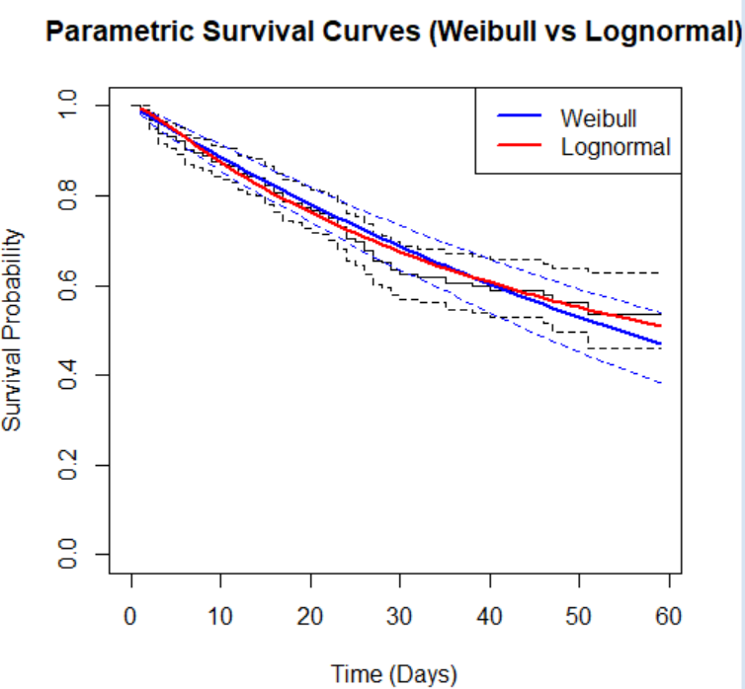
Parametric Survival Models
These models assume specific distributions of survival time.
They predict long-term outcomes and validate Cox results.
AIC Value helps us pick which model is best fit.
Model Type | AIC Value
Weibull | 1178.54
Lognormal | 1177.89
Notes:
This graph demonstrates how each model predicts survival probabilities over time. Both lines are close to the observed data, but the lognormal model slightly outperforms the Weibull based on AIC value, meaning it may be a better fit for this dataset.

Slide 16
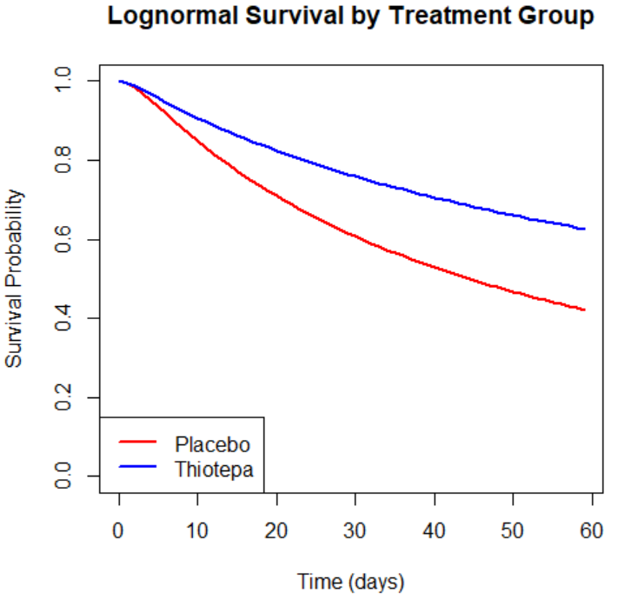
Survival by Treatment-Lognormal
This graph shows survival curves from separate lognormal models for each treatment group.
Red = Placebo, Blue = Thiotepa.
Thiotepa patients had a slower decline in survival probability, indicating better outcomes.
The lognormal model fit the data slightly better than the Weibull model, based on AIC.

Slide 17
Conclusion
Thiotepa significantly lowers recurrence risk.
Patients who had multiple tumors at diagnosis were more likely to experience recurrence.
Clinicians should monitor patients with multiple tumors closely.

Slide 18
References
Babjuk, M., Burger, M., Compérat, E. M., Gontero, P., Liedberg, F., Masson-Lecomte, A., & Shariat, S. F. (2022). EAU guidelines on non-muscle-invasive bladder cancer (Ta, T1 and CIS). European Urology, 81(1), 75–94. https://doi.org/10.1016/j.eururo.2021.10.013
Cambier, S., Sylvester, R. J., Collette, L., Gontero, P., Brausi, M. A., van Andel, G., ... & Witjes, J. A. (2016). EORTC nomograms and risk groups for predicting recurrence, progression, and disease-specific and overall survival in non–muscle-invasive stage Ta–T1 urothelial bladder cancer patients treated with 1–3 years of maintenance Bacillus Calmette–Guérin. European Urology, 69(1), 60–69.
Herr, H. W. (2001). Tumor progression and survival of patients with high grade, noninvasive papillary (TaG3) bladder tumors: 15-year outcome. Journal of Urology, 165(4), 1120–1123.
Kamat, A. M., Hahn, N. M., Efstathiou, J. A., Lerner, S. P., Malats, N., Choi, W., Lotan, Y., & Shariat, S. F. (2016). Bladder cancer. The Lancet, 388(10061), 2796–2810. https://doi.org/10.1016/S0140-6736(16)30561-4
Kaufman, D. S., Shipley, W. U., & Feldman, A. S. (2009). Bladder cancer. The Lancet, 374(9685), 239–249. https://doi.org/10.1016/S0140-6736(09)60491-8
Sylvester, R. J., Van der Meijden, A. P., Oosterlinck, W., Witjes, J. A., Bouffioux, C., Denis, L., & Kurth, K. H. (2006). Predicting recurrence and progression in individual patients with stage Ta T1 bladder cancer using EORTC risk tables. European Urology, 49(3), 466–475. https://doi.org/10.1016/j.eururo.2005.12.031

Slide 19
Thank You
Any Questions?

